Slide 1


IIOT AND INDUSTRY 4.0
VOICE CONTROL WHEEL CHAIR
Team Members :
K.D Karthi
R.Devibalan
S.Mahadevan
V.Vadivel
BE.ECE
M A M College of Engineering

Slide 2

m
PROJECT DESCRIPTION
Development of a Voice-Controlled Wheelchair System Using Arduino, Bluetooth, and DC Motors
Aim :
The aim of the project is to develop a voice-controlled wheelchair system using Arduino, Bluetooth, and DC motors, with the objective of providing enhanced mobility and independence for individuals with mobility impairments.
Components :
Arduino Uno
Bluetooth module
Motor driver L298N
9V Battery
Dc Motor
Jumper wires

Slide 3
PROPOSED IDEA
This project aims to design and implement a voice-controlled wheelchair system utilizing Arduino microcontroller technology, Bluetooth communication, and DC motors controlled by an L298N motor driver.
The system integrates components such as a battery for power supply, jumper wires for circuit connections, and software programmed on the Arduino platform for voice recognition and motor control. Through Bluetooth connectivity, users can issue voice commands to maneuver the wheelchair in various directions, enhancing mobility and independence for individuals with mobility impairments.
The system's architecture and functionality are detailed, including hardware setup, software development, and integration testing.
Preliminary results demonstrate the feasibility and effectiveness of the proposed solution, with potential for further optimization and application in assistive technology for disabled individuals

Slide 4

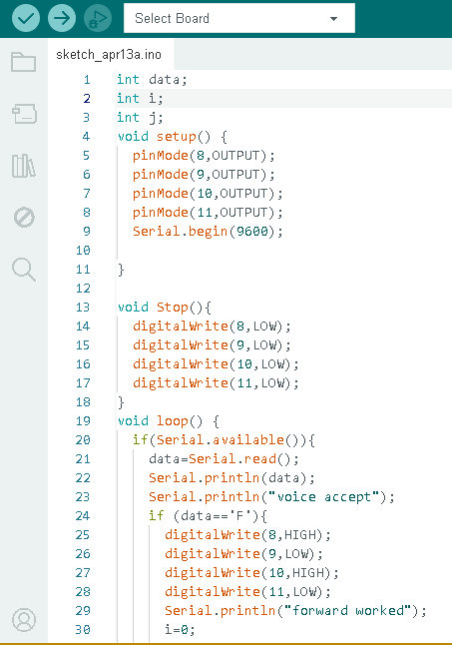
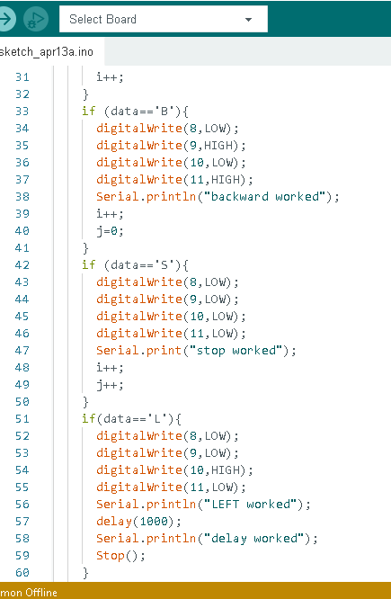
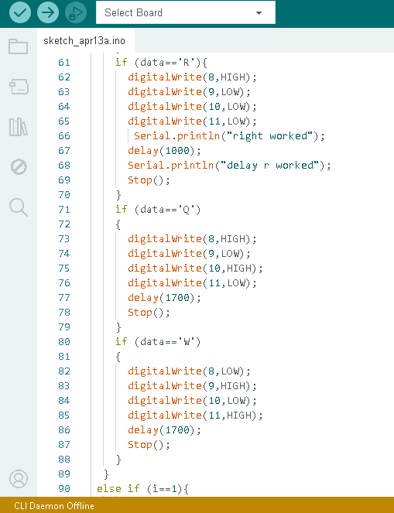
PROGRAM :

Slide 5
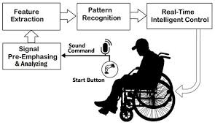
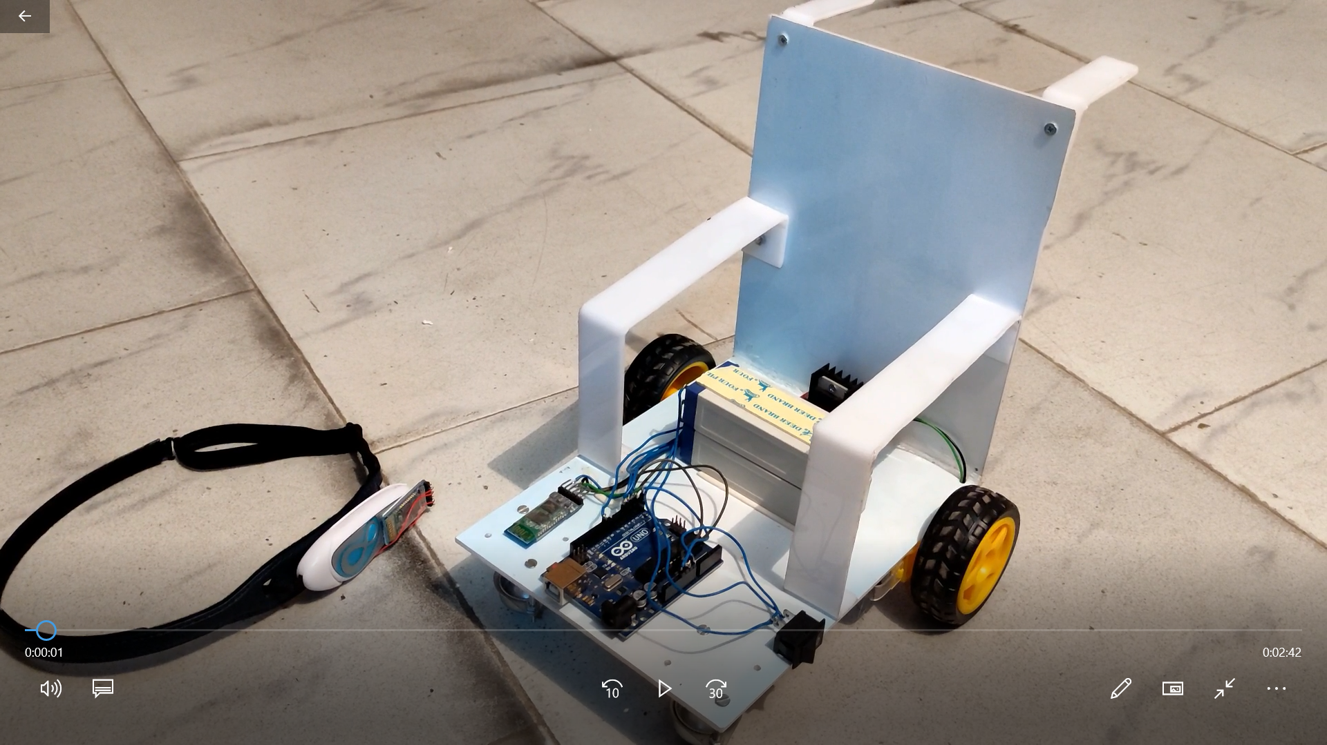
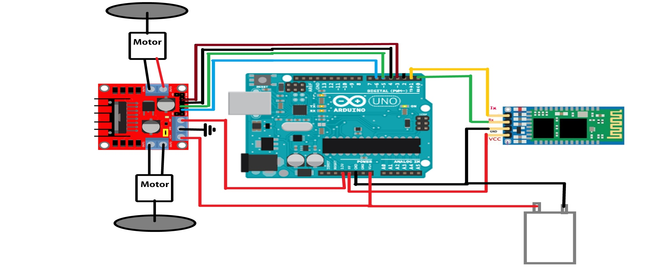
SCHEMATICS & OUTPUTS
Vision

